Slide 1


Building an Anthropic Artifacts-like Feature
Implementing a dual-canvas interface with Next.js, TypeScript, Tailwind CSS, and Convex database

Slide 2


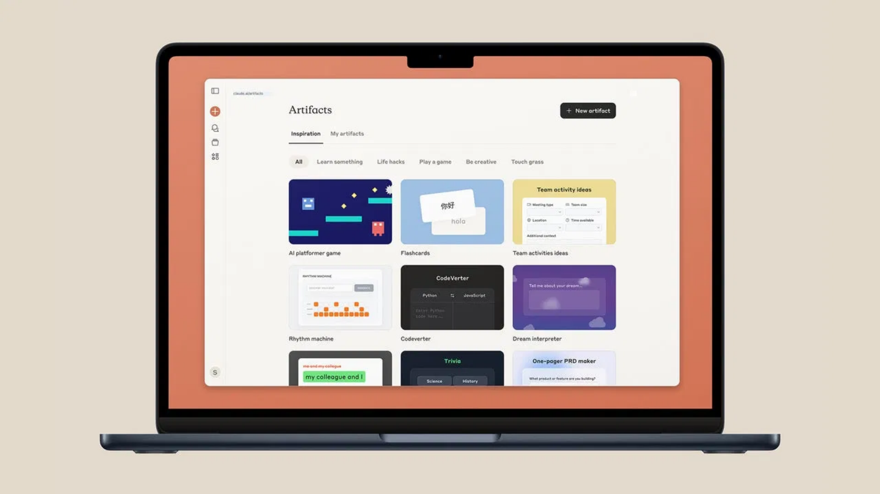



The Dual-Canvas Concept
Chat Interface:
Users interact with an AI model
through natural language prompts, requesting content
generation or modifications.
Editor Canvas:
A rich text editor (TipTap) displays and
allows editing of AI-generated content in real-time.
Seamless Integration:
Changes in either canvas are
synchronized, allowing for iterative refinement between
user and AI.
Collaborative Experience:
Multiple users can view and
edit the same document simultaneously, with real-time
updates.

Slide 3


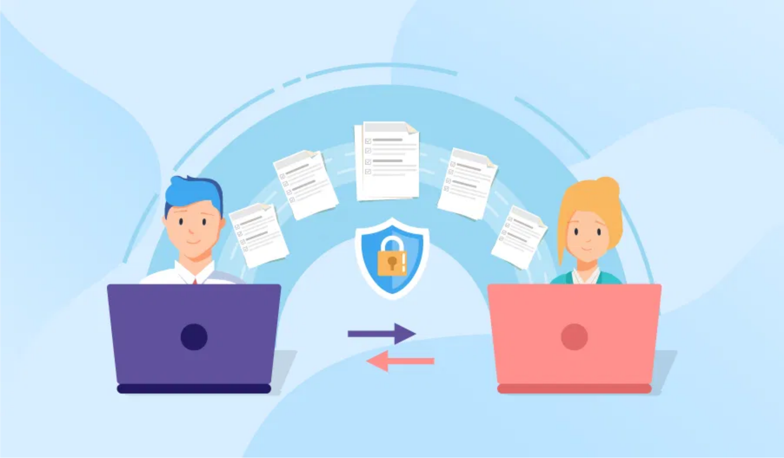



Tech Stack & Architecture
Frontend
Next.js
TypeScript
Tailwind CSS
Shadcn UI Components
Backend & Data
Convex Database
WebSocket Server
Editor & Collaboration
TipTap Editor
ProseMirror
Operational Transformation
AI Integration
LLM API
Context Management

Slide 4

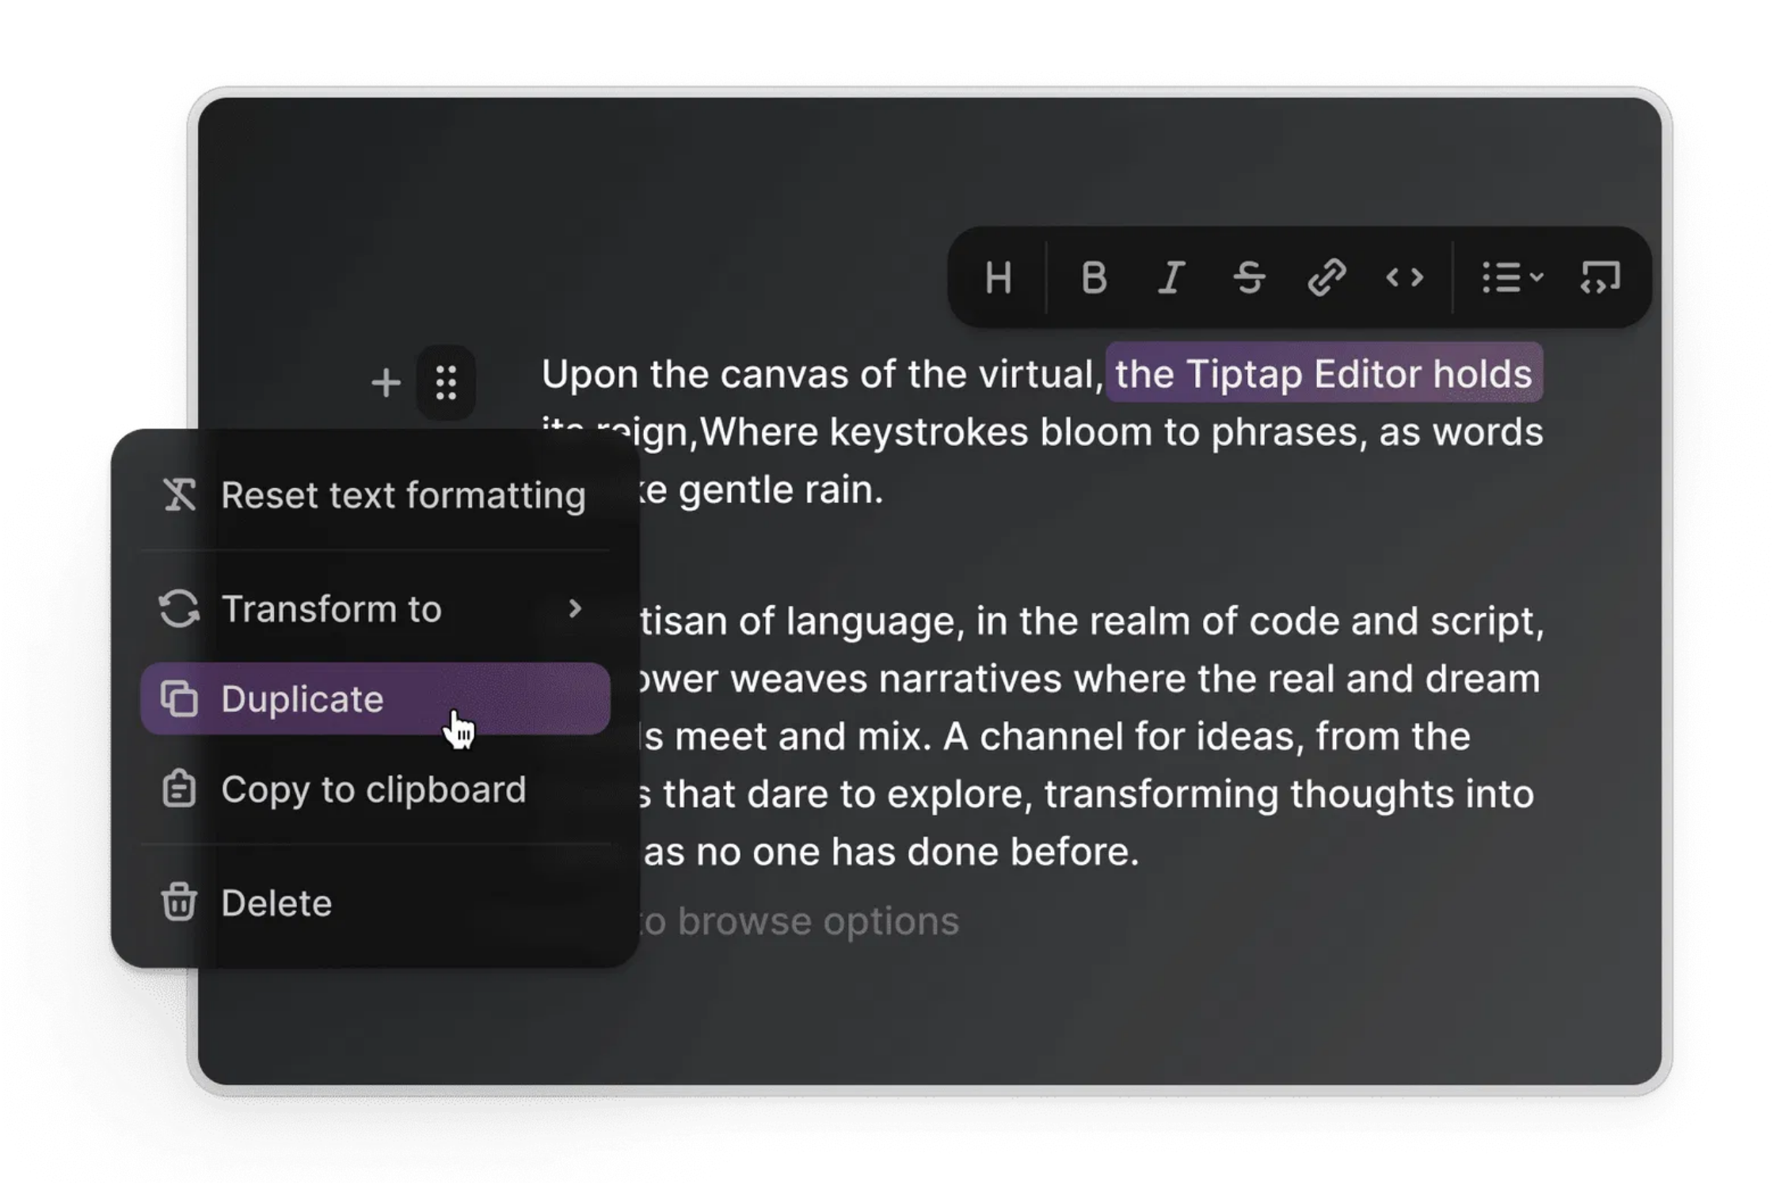
TipTap Editor Integration
1
Install TipTap and Extensions
npm install @tiptap/react @tiptap/starter-kit @tiptap/extension-collaboration
2
Initialize Editor with Collaboration
const editor = useEditor({
extensions: [
StarterKit,
Collaboration.configure({
document: initialDoc
})
]
})
3
Create UI with Shadcn Components
Build toolbar, menus, and editor interface using Shadcn UI components for consistent design.
4
Connect to Real-time Backend
Integrate with WebSocket server (Hocuspocus/Liveblocks) and Convex for persistence.

Slide 5

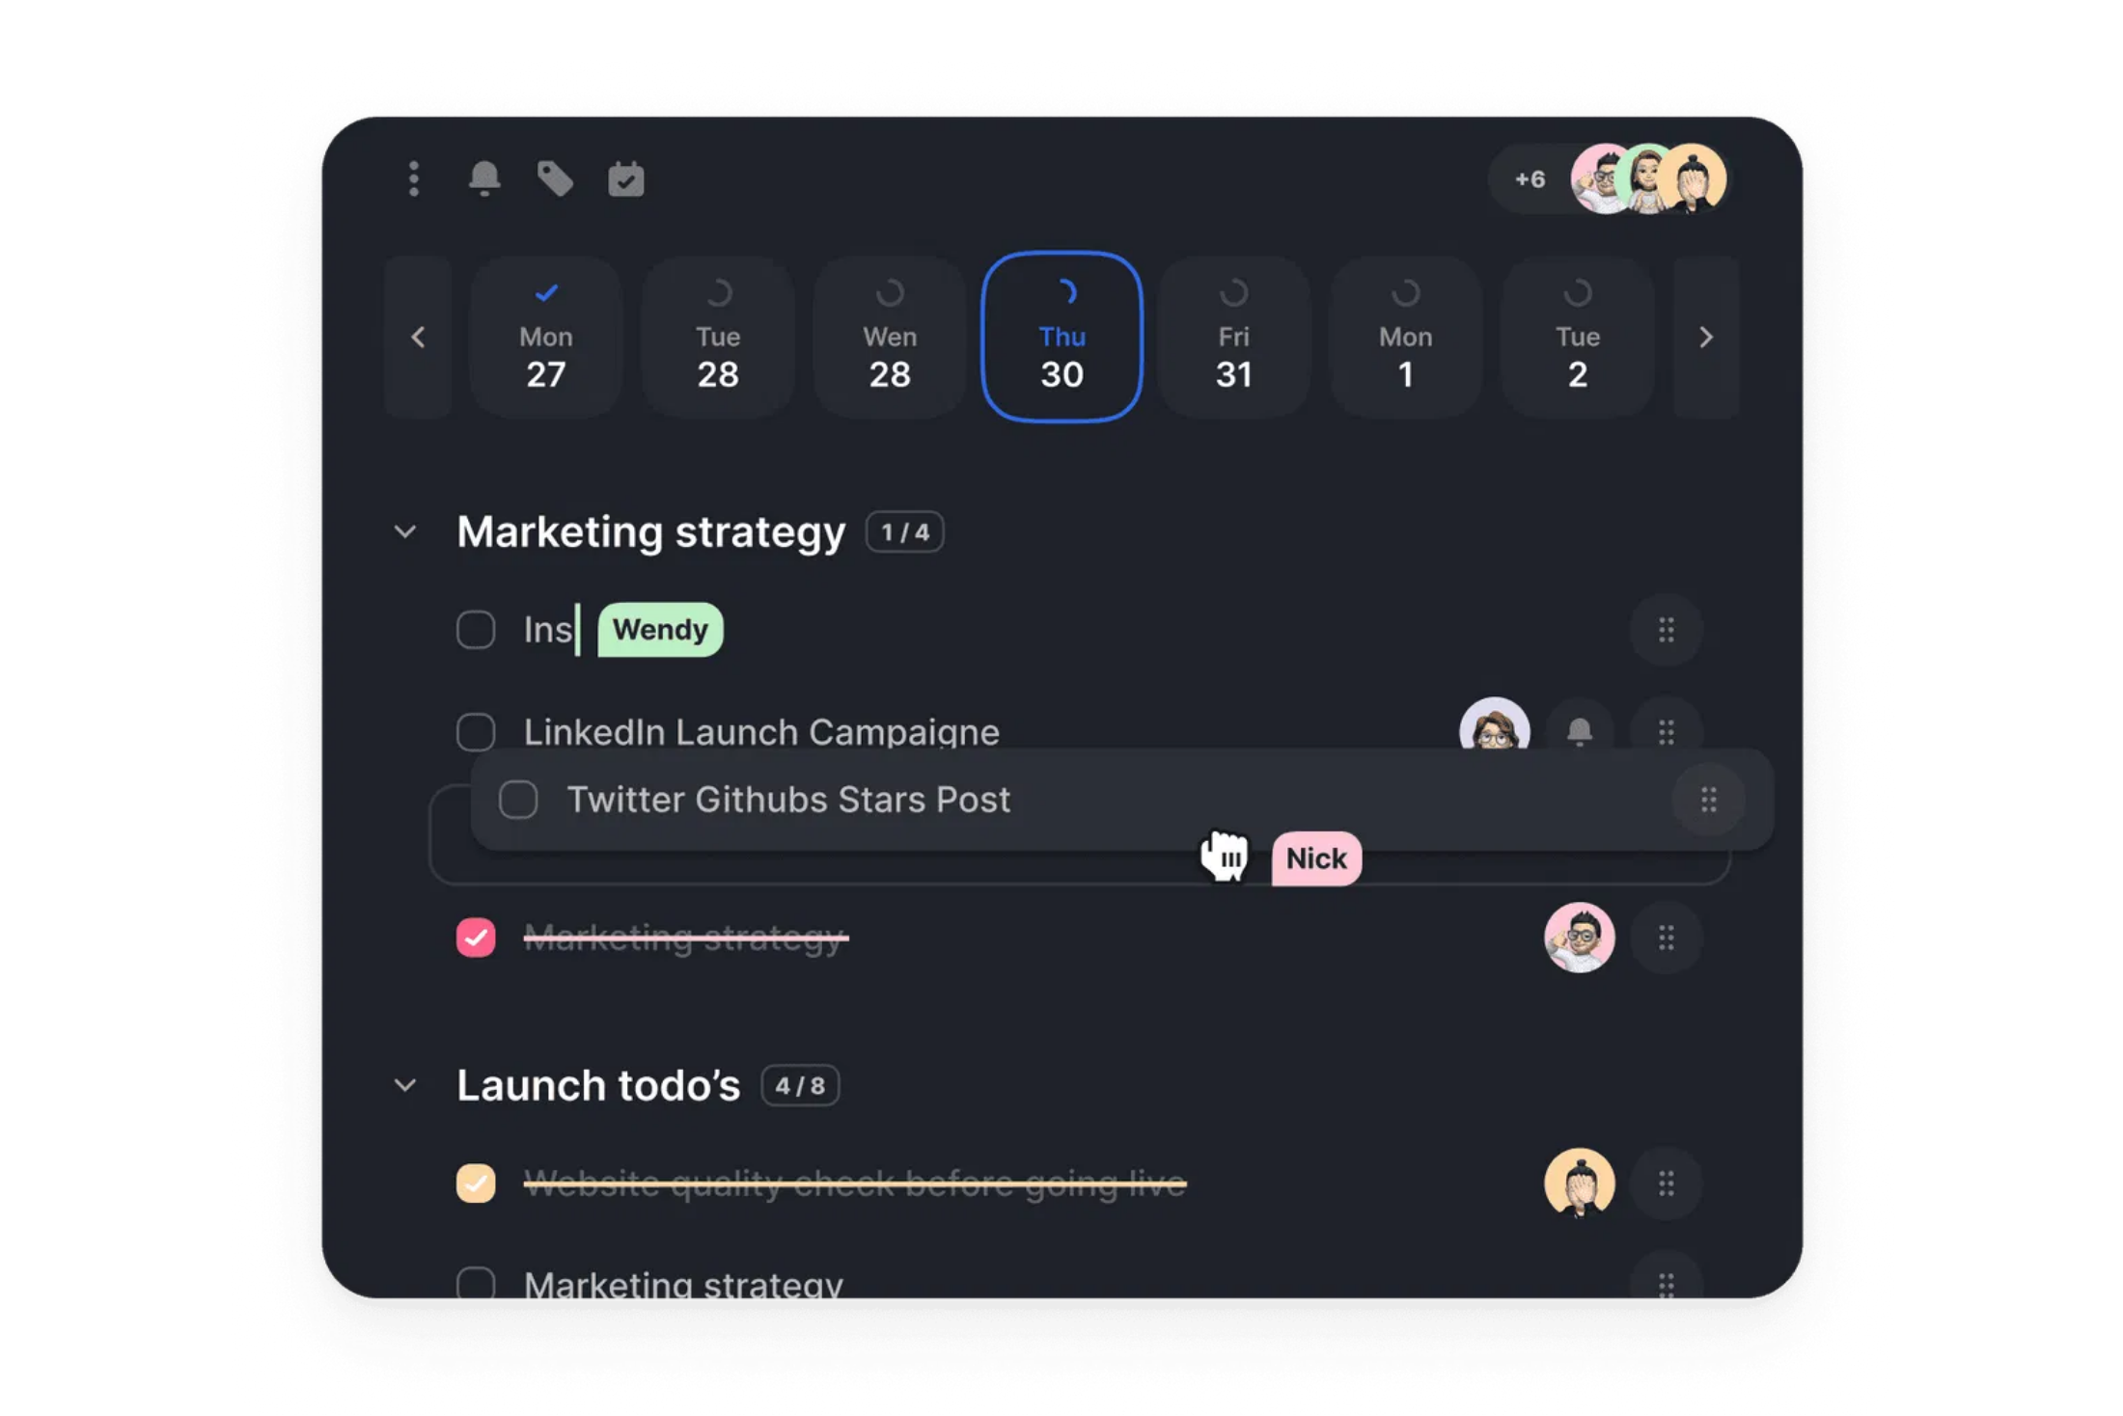



Real-time Collaboration Mechanisms
Operational Transformation (OT)
Algorithm that ensures concurrent edits are merged seamlessly without conflicts.
Conflict-free Replicated Data Types
Data structures that automatically resolve conflicts between concurrent operations.
WebSocket Server
Central hub broadcasting document updates to all connected clients.
Presence & Awareness
Shows other users' cursors, selections, and online status in real-time.

Slide 6

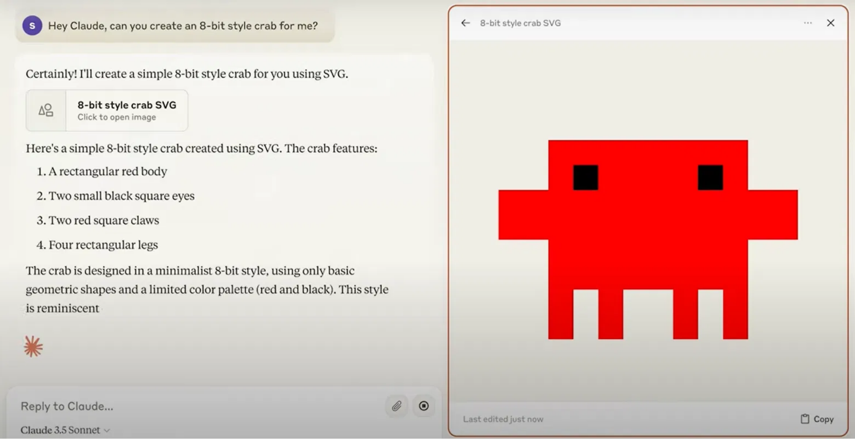


LLM Context Management
Selective Context
Provide only relevant document sections to the LLM rather than the entire document, optimizing context window usage.
Diff-based Edits
Have the LLM generate a set of changes (diff) rather than the full modified document, reducing data transfer and enabling precise control.
Structured Document Representation
Represent documents in structured formats (JSON, Markdown with metadata) to help the LLM understand document structure.
LangChain Integration
Leverage tools like LangChain for document loading, processing, and agentic workflows for complex editing tasks.

Slide 7


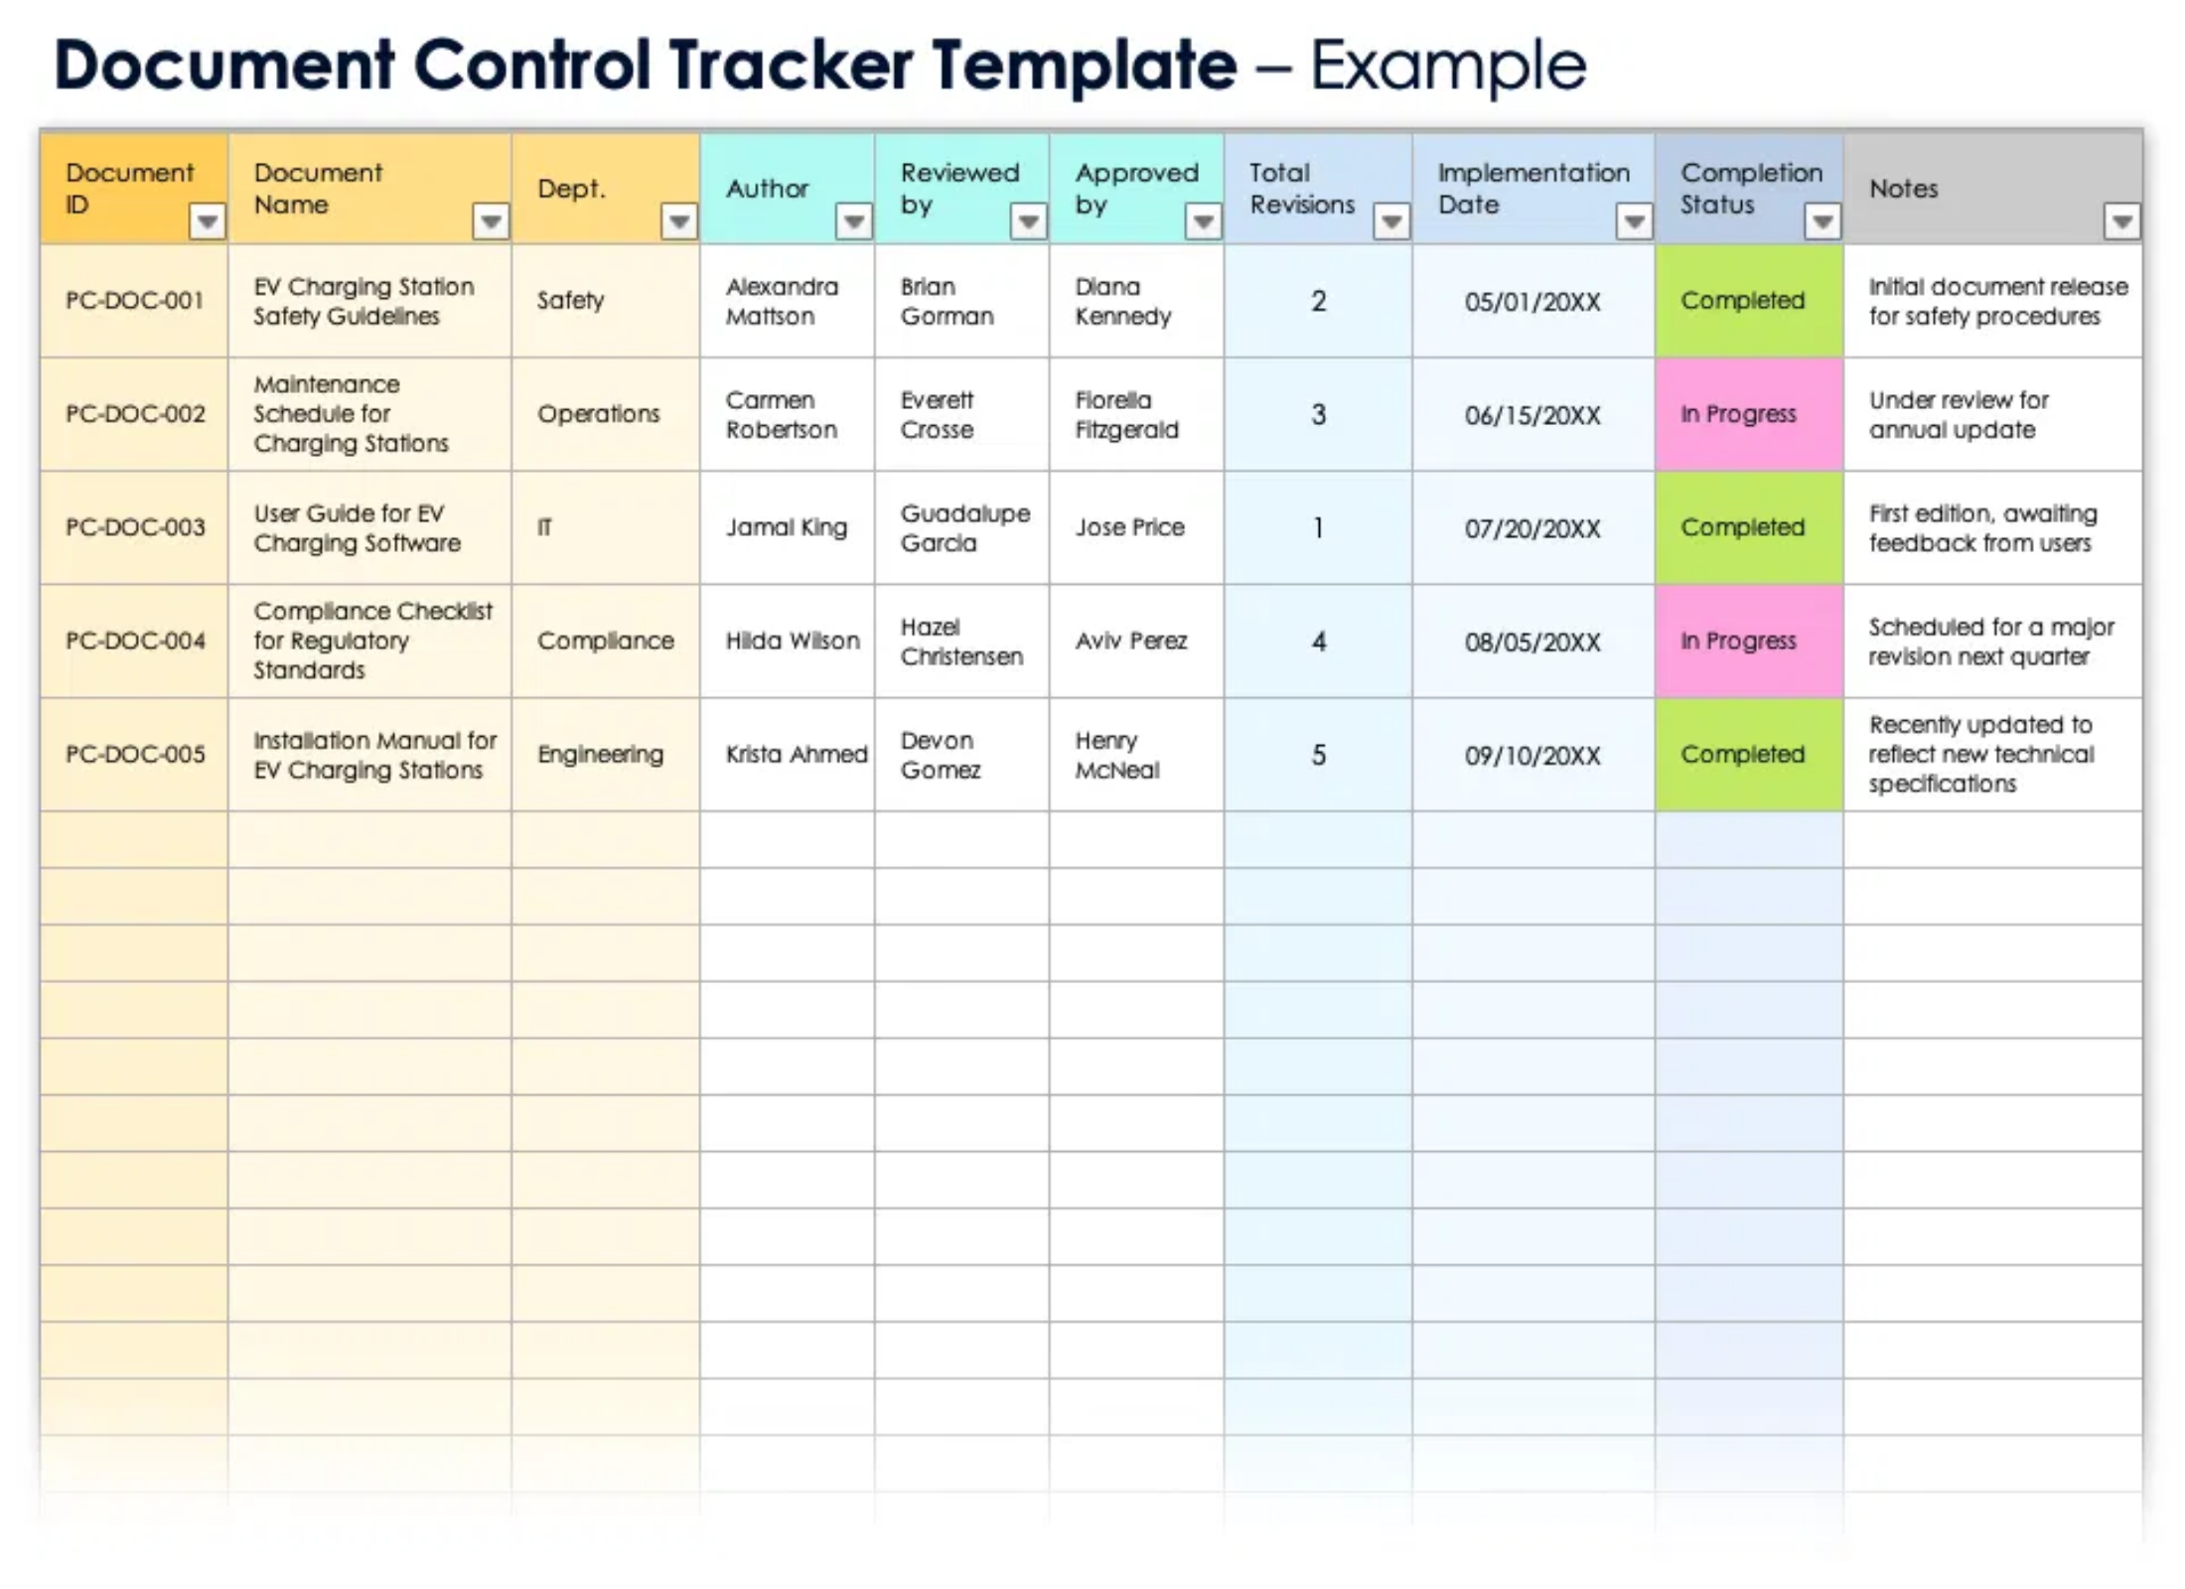


Document State Handling
Operational Transformation for LLM Edits
Treat AI-generated edits as another user's changes, integrating them using the same OT mechanisms to prevent conflicts.
Real-time Synchronization with Convex
Persist document changes to Convex database, which automatically pushes updates to all subscribed clients.
TipTap AI Agent Integration
Leverage TipTap's AI Agent to simplify LLM integration for reading, rewriting, and formatting rich text.
LLM Edit Workflow
1
2
3
4
User requests edit via chat
App gathers document context
LLM generates structured edits
Changes applied & synchronized

Slide 8

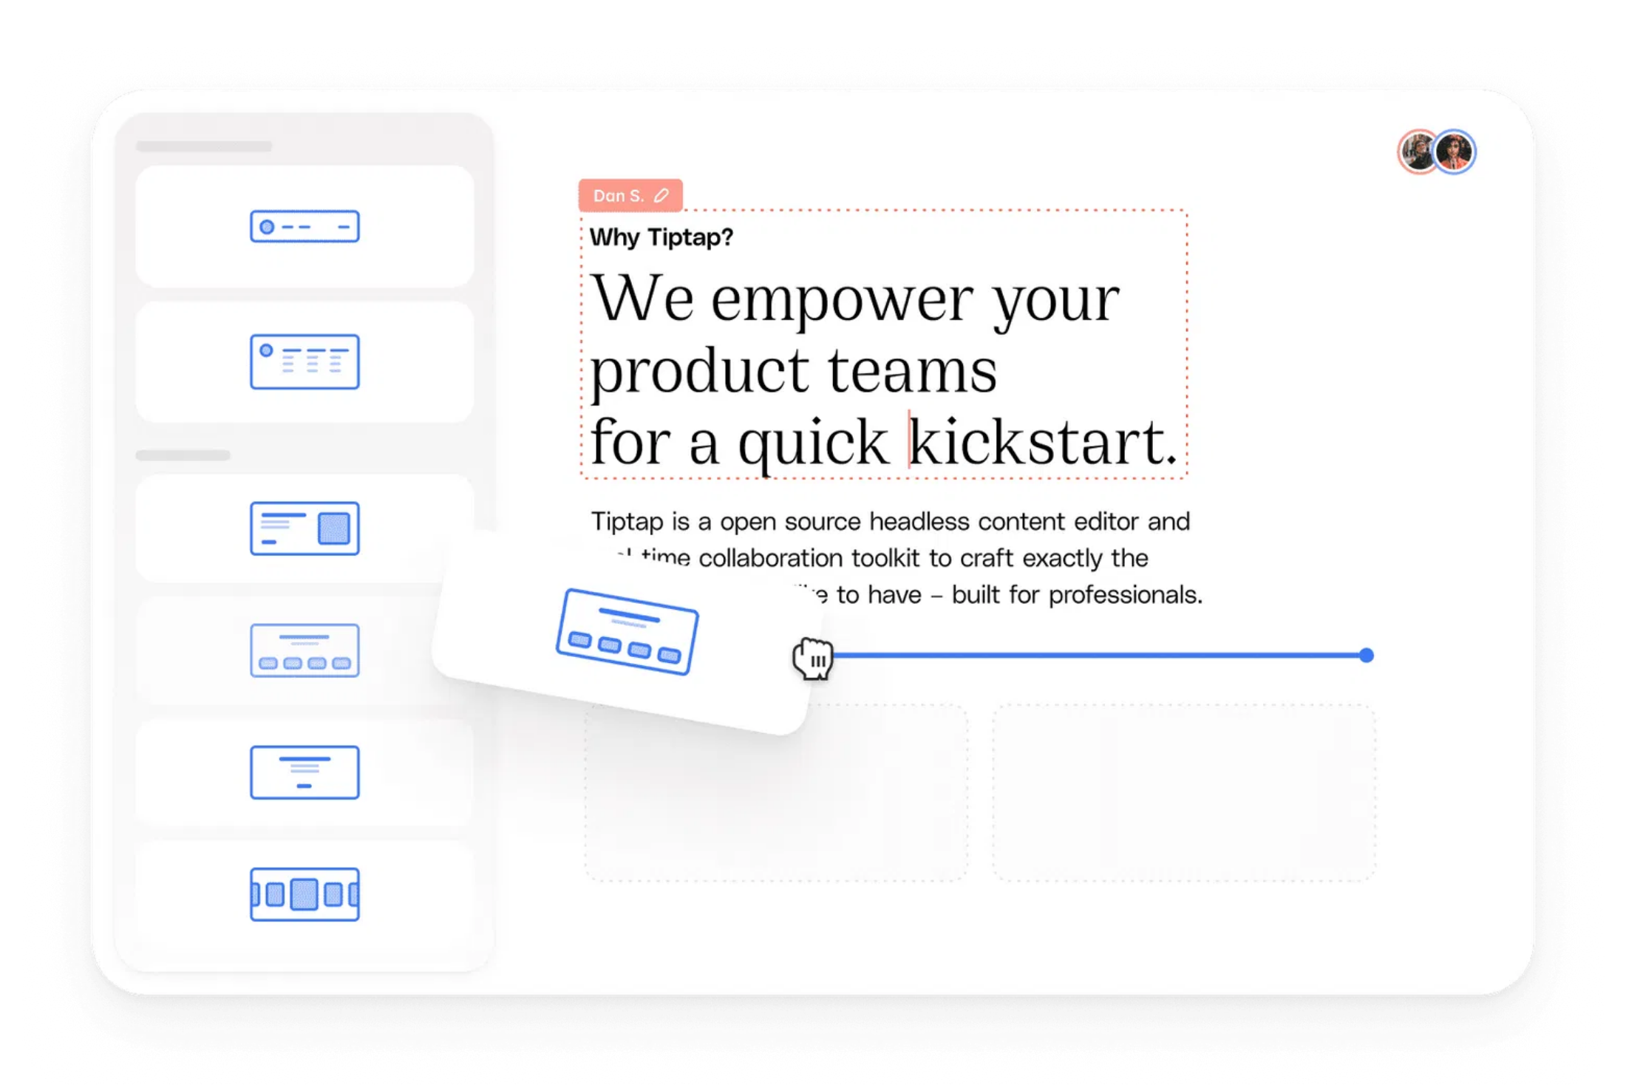



Real-time Edit Indicators
Presence Indicators
Show which users are currently active in the document with
avatars and status indicators.
User 1
User 2
AI Assistant
Awareness Indicators
Display each user's cursor position and text selection in real-time with color-coded highlights.
Change Highlighting
Temporarily highlight modified text with background colors or underlines to draw attention to recent changes.
AI-specific Indicators
Use distinct visual styles for AI-driven changes to differentiate them from human edits, with options for user confirmation.

Slide 9

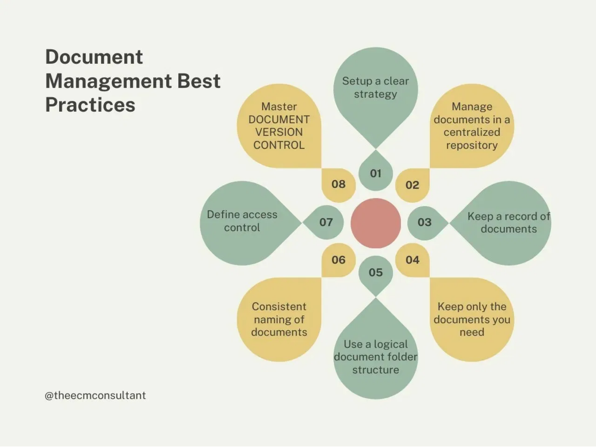


Visual Feedback Systems
Decorations API
Apply styling to document ranges without modifying content,
ideal for highlighting changes and showing selections.
editor.decorations.add([
{
from: 10, to: 20,
attrs: { class: 'ai-edit-highlight' }
}
])
Custom Nodes & Marks
Create specialized content types for comments, annotations, or other visual feedback elements with custom rendering.
Track Changes Implementation
Build a formal review system allowing users to accept or reject changes, with visual indicators for additions, deletions, and modifications.

Slide 10


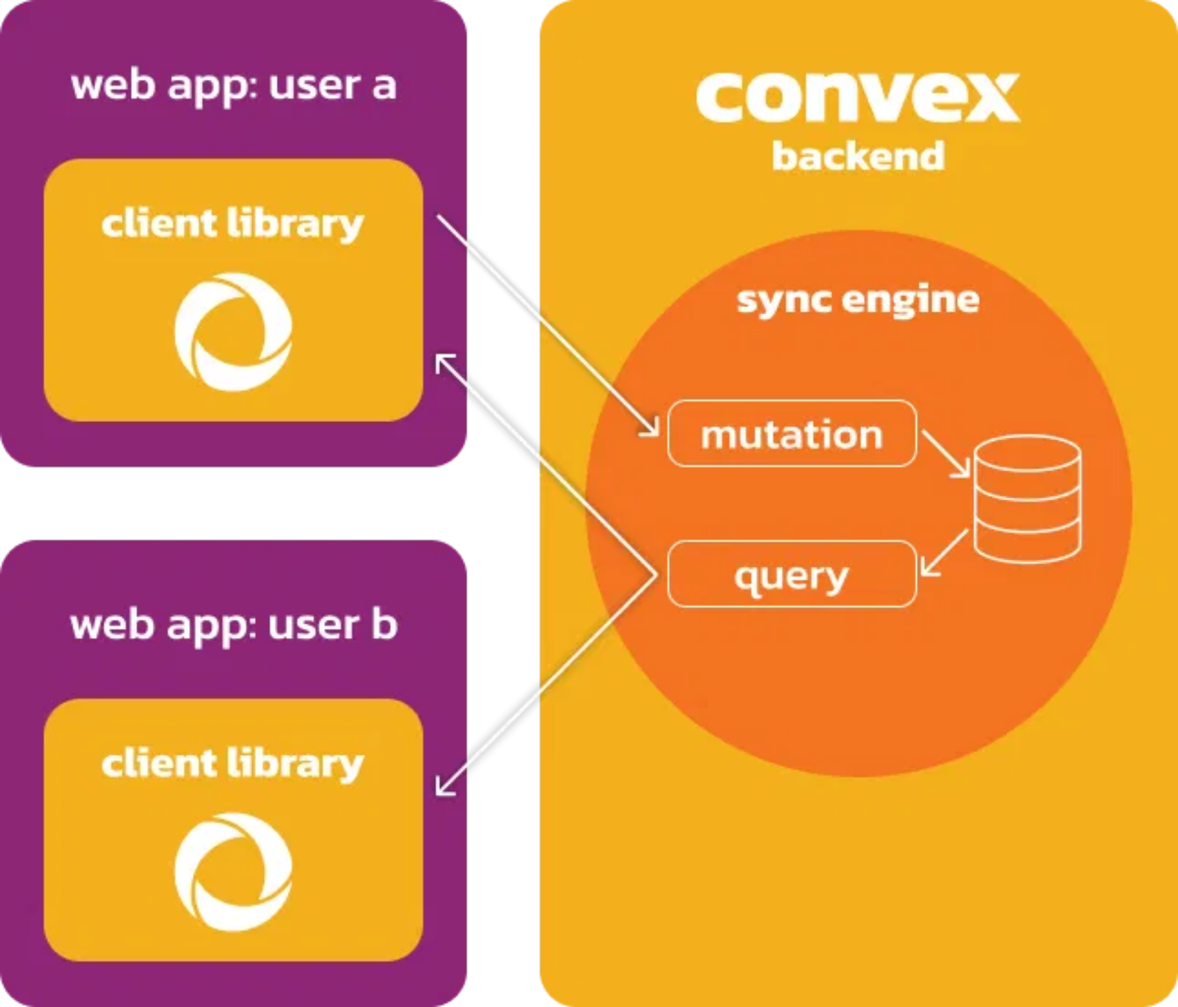



Convex Database for Real-time Persistence
Reactive Queries
Automatically re-executes queries when underlying data
changes, pushing fresh results to all subscribed clients.
// React client
const document = useQuery(api.documents.getDocument, {
documentId
});
Document Store
Flexible storage for rich text content as JSON, perfectly suited for ProseMirror's document model.
ProseMirror Sync Component
Convex provides a dedicated component for syncing TipTap/ProseMirror with the database, handling operational transformations.
Server Functions
Secure mutations and actions for applying document changes and enforcing business logic.

Slide 11


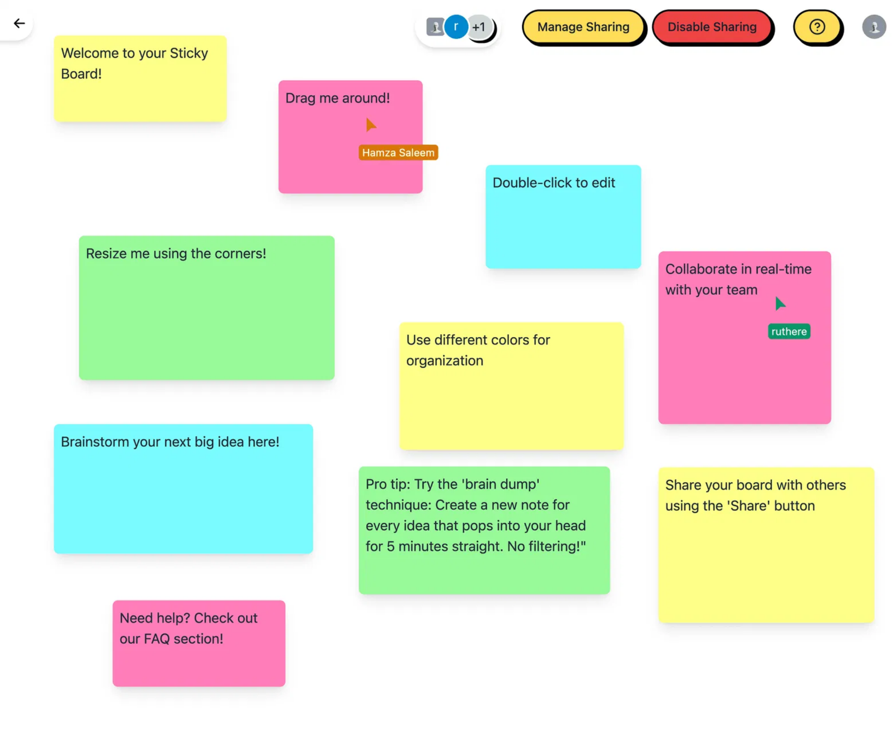


Anthropic Artifacts Implementation Patterns
Core Concept
Interactive windows displaying AI-generated content that can be further refined by both user and AI in real-time.
LLM Access to Artifact State
The LLM must be able to read the current content of artifacts to make targeted edits, using selective context techniques.
Structured LLM Output
LLM generates structured data for edits (JSON objects describing insertions, deletions, replacements) rather than full document rewrites.
Inferred Workflow
1.
User prompt in chat interface
2.
LLM processes prompt with artifact context
3.
Backend orchestrates changes to document
4.
Frontend renders updates with visual indicators

Slide 12






Conclusion & Key Takeaways
TipTap for Rich Text Editing
Leverage TipTap's extensibility and Collaboration extension with WebSocket servers for robust real-time collaborative editing.
Intelligent LLM Context Management
Provide only necessary document context to the LLM and have it generate structured edits rather than full document rewrites.
Clear Visual Feedback
Implement comprehensive visual indicators for presence, awareness, and AI-driven changes with distinct styling.
Convex for Real-time Persistence
Harness Convex's reactive database capabilities to store and synchronize document state in real-time across all clients.
By integrating these technologies effectively, you can create a powerful human-AI collaborative content creation platform.

